Slide 1

Marketing is crucial for the growth and sustainability of any business.
Marketers can help build the company’s brand, engage customers, grow revenue, and increase sales.
EDUCATION
(Marketers educate and communicate value proposition to customers)
ENGAGEMENT
(Marketers engage customers and understand their needs)
DRIVE SALES
(Marketers drive sales and traffic to products/services)
GROWTH
(Marketers empower business growth by reaching new customers)

Slide 2
One of the key pain points for marketers is to know their customers and identify their needs.
By understanding the customer, marketers can launch a targeted marketing campaign that is tailored for specific needs.
If data about the customers is available, data science can be applied to perform market segmentation.

Slide 3
In this case study, you have been hired as a consultant to a bank in New York City.
The bank has extensive data on their customers for the past 6 months.
The marketing team at the bank wants to launch a targeted ad marketing campaign by dividing their customers into at least 3 distinctive groups.

Slide 4
# CUSTID: Identification of Credit Card holder
# BALANCE: Balance amount left in customer's account to
make purchases
# BALANCE_FREQUENCY: How frequently the Balance is
updated, score between 0 and 1 (1 = frequently updated, 0 = not frequently updated)
# PURCHASES: Amount of purchases made from account
# ONEOFFPURCHASES: Maximum purchase amount done in one-go
# INSTALLMENTS_PURCHASES: Amount of purchase done in installment
# CASH_ADVANCE: Cash in advance given by the user
# PURCHASES_FREQUENCY: How frequently the Purchases are being made, score between 0 and 1 (1 = frequently purchased, 0 = not frequently purchased)

Slide 5
# PURCHASES_FREQUENCY: How frequently
the Purchases are being made, score between 0 and 1 (1 = frequently purchased, 0 = not frequently purchased)
# ONEOFF_PURCHASES_FREQUENCY: How
frequently Purchases are happening in one-go (1 = frequently purchased, 0 = not frequently purchased)
# PURCHASES_INSTALLMENTS_FREQUENCY: How frequently purchases in installments are being done (1 = frequently done, 0 = not frequently done)
# CASH_ADVANCE_FREQUENCY: How
frequently the cash in advance being paid

Slide 6
# CASH_ADVANCE_TRX: Number of Transactions made with "Cash in Advance"
# PURCHASES_TRX: Number of purchase
transactions made
# CREDIT_LIMIT: Limit of Credit Card for user
# PAYMENTS: Amount of Payment done by user
# MINIMUM_PAYMENTS: Minimum amount of
payments made by user
# PRC_FULL_PAYMENT: Percent of full payment paid by user
# TENURE: Tenure of credit card service for user

Slide 7
K-MEANS INTUITION
K-means is an unsupervised learning algorithm (clustering).
K-means works by grouping some data points together (clustering) in an unsupervised fashion.
The algorithm groups observations with similar attribute values together by measuring the Euclidian distance between points.
AGE
AGE
K-MEANS
SAVINGS
SAVINGS

Slide 8
K-MEANS ALGORITHM STEPS
Choose number of clusters “K”
Select random K points that are going to be the centroids for each cluster
Assign each data point to the nearest centroid, doing so will enable us to create “K” number of clusters
Calculate a new centroid for each cluster
Reassign each data point to the new closest centroid
Go to step 4 and repeat.

Slide 9
AGE
AGE
Place K centroids for each cluster
Assign each data point to the nearest centroid
SAVINGS
SAVINGS
AGE
AGE
Repeat!
Calculate a new centroid for each cluster
SAVINGS
SAVINGS

Slide 10

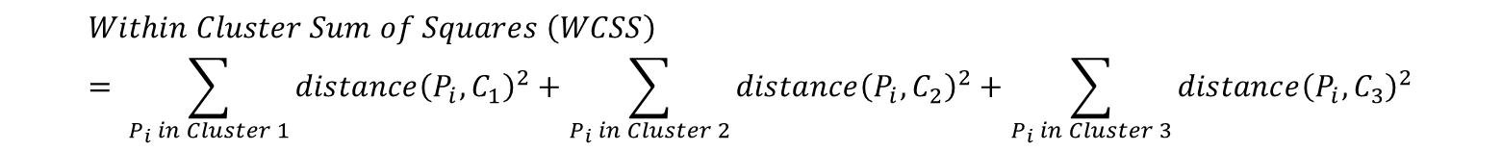





HOW TO SELECT THE OPTIMAL NUMBER OF CLUSTERS (K)? “ELBOW METHOD”
$$Within Cluster Sum of Squares \left(WCSS\right)= \sum_{P_{i} in Cluster 1}{distance{\left(P_{i}, C_{1}\right)}^{2}}+\sum_{P_{i} in Cluster 2}{distance{\left(P_{i}, C_{2}\right)}^{2}+\sum_{P_{i} in Cluster 3}{distance{\left(P_{i}, C_{3}\right)}^{2}}}$$
$$P_{i}$$
AGE
$$C_{3}$$
$$P_{i}$$
$$C_{1}$$
$$P_{i}$$
$$C_{2}$$
SAVINGS

Slide 11


HOW TO SELECT THE OPTIMAL NUMBER OF CLUSTERS (K)? “ELBOW METHOD”
$$Within Cluster Sum of Squares \left(WCSS\right)= \sum_{P_{i} in Cluster 1}{distance{\left(P_{i}, C_{1}\right)}^{2}}$$
NUMBER OF CLUSTERS (K) = 1
AGE
$$P_{i}$$
$$C_{1}$$
SAVINGS

Slide 12


HOW TO SELECT THE OPTIMAL NUMBER OF CLUSTERS (K)? “ELBOW METHOD”
$$Within Cluster Sum of Squares \left(WCSS\right)= \sum_{P_{i} in Cluster 1}{distance{\left(P_{i}, C_{1}\right)}^{2}}+\sum_{P_{i} in Cluster 2}{distance{\left(P_{i}, C_{2}\right)}^{2}}$$
NUMBER OF CLUSTERS (K) = 2
$$P_{i}$$
AGE
$$C_{2}$$
$$P_{i}$$
$$C_{1}$$
SAVINGS

Slide 13
HOW TO SELECT THE OPTIMAL NUMBER OF CLUSTERS (K)? “ELBOW METHOD”
$$Within Cluster Sum of Squares \left(WCSS\right)= \sum_{P_{i} in Cluster 1}{distance{\left(P_{i}, C_{1}\right)}^{2}}+\sum_{P_{i} in Cluster 2}{distance{\left(P_{i}, C_{2}\right)}^{2}+\sum_{P_{i} in Cluster 3}{distance{\left(P_{i}, C_{3}\right)}^{2}}}$$
$$P_{i}$$
AGE
$$C_{3}$$
$$P_{i}$$
$$C_{1}$$
$$P_{i}$$
$$C_{2}$$
SAVINGS

Slide 14
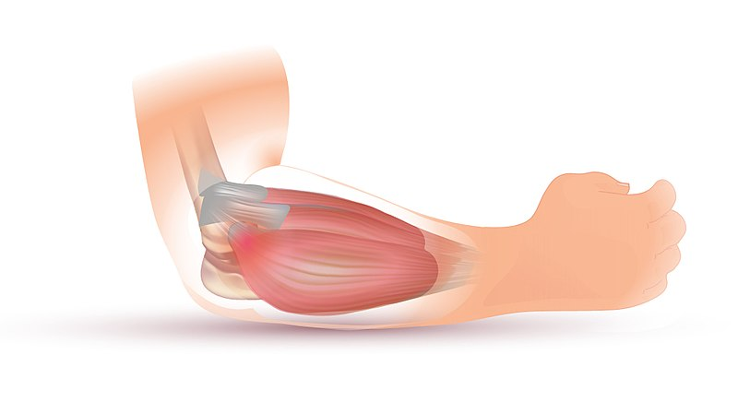
HOW TO SELECT THE OPTIMAL NUMBER OF CLUSTERS (K)? “ELBOW METHOD”
OPTIMAL “K”
WITHIN CLUSTERS SUM OF SQUARES (WCSS)
NUMBER OF CLUSTERS “K”
Source: https://commons.wikimedia.org/wiki/File:Tennis_Elbow_Illustration.jpg

Slide 15

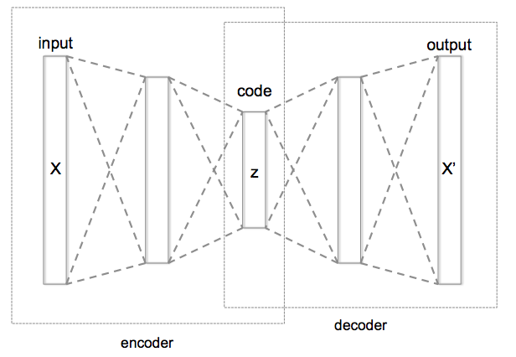
AUTOENCODERS INTUITION
Auto encoders are a type of Artificial Neural Networks that are used to perform a task of data encoding (representation learning).
Auto encoders use the same input data for the input and output, Sounds crazy right!?
AUTOENCODERS UNSUPERVISED
TRAINING
TARGET (TRUE)
LABEL = CAT
ENCODED CAT IMAGE
Photo Credit: https://commons.wikimedia.org/wiki/File:Autoencoder_structure.png
Photo Credit: https://commons.wikimedia.org/wiki/File:Artificial_neural_network_image_recognition.png
Photo Credit: https://www.pexels.com/photo/grey-and-white-short-fur-cat-104827/

Slide 16
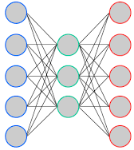
THE CODE LAYER
Auto encoders work by adding a bottleneck in the network.
This bottleneck forces the network to create a compressed (encoded) version of the original input
Auto encoders work well if correlations exists between input data (performs poorly if the all input data is independent)
BOTTLENECK
“CODE LAYER”
(i.e.: ENCODED CAT IMAGE)
ENCODER
DECODER
Photo Credit: https://commons.wikimedia.org/wiki/File:Autoencoder_structure.png
Photo Credit: https://commons.wikimedia.org/wiki/File:Artificial_neural_network_image_recognition.png
Photo Credit: https://www.pexels.com/photo/grey-and-white-short-fur-cat-104827/

Slide 17
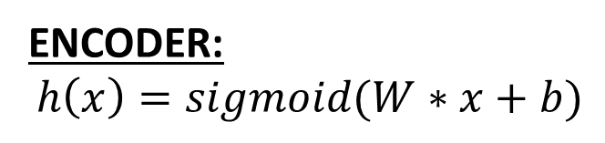


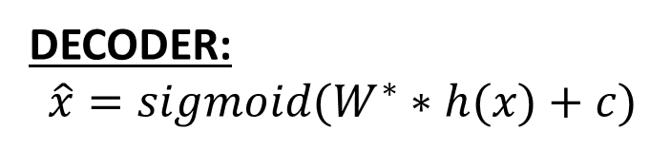
AUTOENCODER MATH
W
W*
x
$$\hat{x}$$
ENCODER:
$$h\left(x\right)=sigmoid(W∗x+b)$$
h(x)
DECODER:
$$\hat{x}=sigmoid(W^{∗}∗h(x)+c)$$
TIED WEIGHTS:
Weights from input to hidden layer will be equal to the weights from hidden layer to output
$$W^{∗}=W^{T}$$
ENCODER
DECODER
Photo Credit: https://commons.wikimedia.org/wiki/File:Autoencoder_structure.png
Photo Credit: https://commons.wikimedia.org/wiki/File:Artificial_neural_network_image_recognition.png
Photo Credit: https://www.pexels.com/photo/grey-and-white-short-fur-cat-104827/

Slide 18
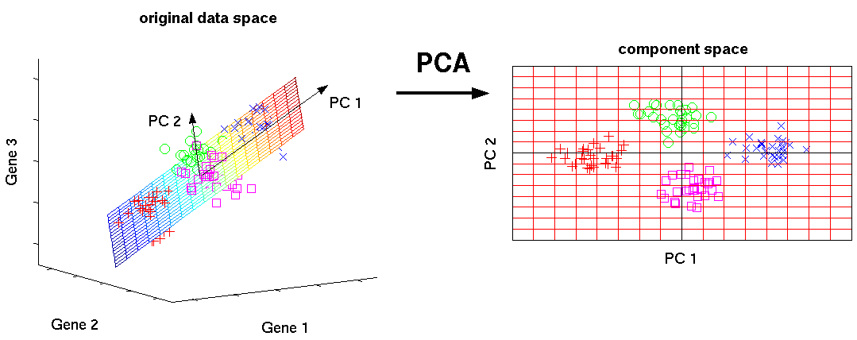
PRINCIPAL COMPONENT ANALYSIS: OVERVIEW
PCA is an unsupervised machine learning algorithm.
PCA performs dimensionality reductions while attempting at keeping the original information unchanged.
PCA works by trying to find a new set of features called components.
Components are composites of the uncorrelated given input features.
Photo Credit: http://phdthesis-bioinformatics-maxplanckinstitute-molecularplantphys.matthias-scholz.de/

